Slide 1




Tamenny
App Is Coming
Empowering individuals with AI-driven healthcare insights, Tamenny bridges the gap between timely self-diagnosis and professional consultation, ensuring a healthier and more informed future.
Don’t Miss Out

Slide 2

Tamenny
AI-based Healthcare Diagnostics for Preliminary Assessments
Graduation project
2024-2025
Tamenny
Start Page
>

Slide 3
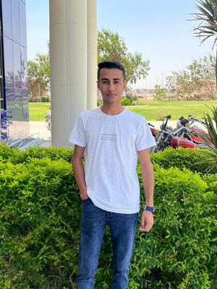
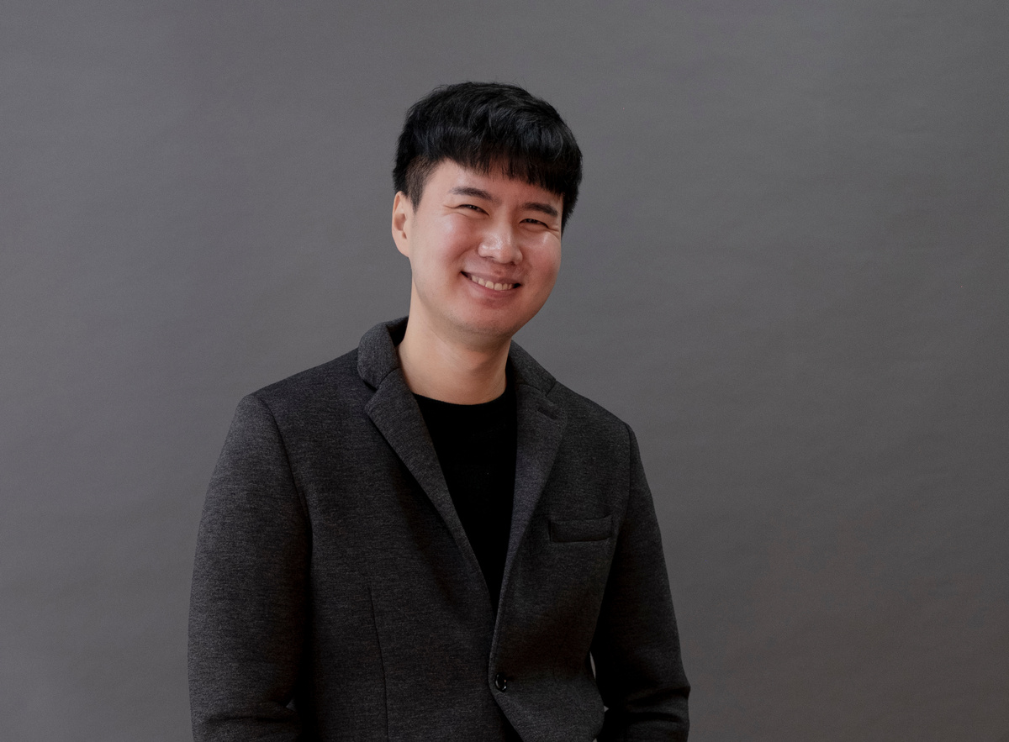
OUR TEAM
Howard Ong
Job Position
Olivia Wilson
Howard Ong
Howard Ong
Job Position
Job Position
Job Position
Howard Ong
Job Position
Howard Ong
Howard Ong
Olivia Wilson
Job Position
Job Position
Job Position

Slide 4
Agenda
1
2
3
4
5
Abstract
Introduction
Motivation
Problem Statement
Proposed Solution
AI-driven diagnosis, saving time, empowering healthcare.
Revolutionizing healthcare with smart technology solutions
Empowering users with timely health insights
Long waits hinder timely health interventions.
AI-powered preliminary diagnosis for faster care
6
7
8
9
10
Key Features
Technology Stack
Implementation Details
Competitive Analysis
Results and Achievements
Smart diagnostics, seamless interface, user-centric design
Leveraging modern AI, mobile, and cloud technologies
"Efficiently developed using agile methods and tools."
Standing out with precision and speed
Delivering accurate diagnoses, enhancing user trust
11
12
13
Future Work
Conclusion
Thank You
Expanding features, improving accuracy and scalability
Transforming healthcare with AI-powered solutions
Grateful for your attention and support

Slide 5

Tamenny
Abstract

Slide 6
Tamenny
Tamenny is a revolutionary mobile app that leverages AI to provide users with quick, preliminary health diagnoses based on scans or images of medical reports. Users upload their scans, and the app uses advanced machine learning algorithms to analyze the data and offer insights into potential health conditions. Tamenny not only empowers users with immediate health information but also allows them to share their scans with others and consult with doctors, ensuring a collaborative approach to healthcare. With a user-friendly interface, Tamenny streamlines the diagnostic process while prioritizing privacy and security.

Slide 7
